Slide 1
GraphGame ggl008-Fire
Plakátok, részecskerendszerek
Szécsi László

Slide 2
Particle osztály
#include "Egg/Math/math.h"
class Particle {
public:
Egg::Math::Float3 position;
Egg::Math::Float3 velocity;
float lifespan;
float age;
};

Slide 3
Particle osztály
void reborn() {
using namespace Egg::Math;
position =
Float3::Random(-1,1);
velocity = position * 5;
age = 0;
lifespan =
Float1::Random(2,5).x;
}
Particle(){ reborn(); }

Slide 4
ggl008App.h
#include "Particle.h"
#include <vector>

Slide 5
ggl008App.h
std::vector<Particle> particles;
Egg::Mesh::VertexStreamGeometry::P particlesGeometry;
Egg::Mesh::Shaded::P
fireBillboardSet;

Slide 6
Geometry
D3D12_PRIMITIVE_TOPOLOGY_TYPE GetTopologyType() const {
switch (topology) {
case D3D_PRIMITIVE_TOPOLOGY_POINTLIST:
return D3D12_PRIMITIVE_TOPOLOGY_TYPE_POINT;
case D3D_PRIMITIVE_TOPOLOGY_LINELIST:
case D3D_PRIMITIVE_TOPOLOGY_LINESTRIP:
return D3D12_PRIMITIVE_TOPOLOGY_TYPE_LINE;
case D3D_PRIMITIVE_TOPOLOGY_TRIANGLESTRIP:
case D3D_PRIMITIVE_TOPOLOGY_LINELIST_ADJ:
case D3D_PRIMITIVE_TOPOLOGY_LINESTRIP_ADJ:
case D3D_PRIMITIVE_TOPOLOGY_TRIANGLELIST_ADJ:
case D3D_PRIMITIVE_TOPOLOGY_TRIANGLESTRIP_ADJ:
case D3D_PRIMITIVE_TOPOLOGY_TRIANGLELIST:
return D3D12_PRIMITIVE_TOPOLOGY_TYPE_TRIANGLE;
default:
return D3D12_PRIMITIVE_TOPOLOGY_TYPE_PATCH;
}
}

Slide 7
Shaded constructor
gpsoDesc.PrimitiveTopologyType = geom->GetTopologyType();

Slide 8
LoadAssets
for(int i=0; i<40; i++)
particles.push_back(Particle());

Slide 9
LoadAssets
particlesGeometry =
Egg::Mesh::VertexStreamGeometry::Create(device.Get(),
particles.data(),
sizeof(particles[0]) * particles.size(),
sizeof(particles[0]));
particlesGeometry->SetTopology( D3D_PRIMITIVE_TOPOLOGY_POINTLIST);

Slide 10
LoadAssets
D3D12_INPUT_ELEMENT_DESC particlePositionDesc;
particlePositionDesc.AlignedByteOffset = offsetof(Particle, position);
particlePositionDesc.Format = DXGI_FORMAT_R32G32B32_FLOAT;
particlePositionDesc.InputSlot = 0;
particlePositionDesc.InputSlotClass = D3D12_INPUT_CLASSIFICATION_PER_VERTEX_DATA;
particlePositionDesc.InstanceDataStepRate = 0;
particlePositionDesc.SemanticIndex = 0;
particlePositionDesc.SemanticName = "POSITION";
particlesGeometry->AddInputElement( particlePositionDesc);

Slide 11
LoadAssets
D3D12_INPUT_ELEMENT_DESC particleLifespanDesc;
particleLifespanDesc.AlignedByteOffset = offsetof(Particle, lifespan);
particleLifespanDesc.Format = DXGI_FORMAT_R32_FLOAT;
particleLifespanDesc.InputSlot = 0;
particleLifespanDesc.InputSlotClass = D3D12_INPUT_CLASSIFICATION_PER_VERTEX_DATA;
particleLifespanDesc.InstanceDataStepRate = 0;
particleLifespanDesc.SemanticIndex = 0;
particleLifespanDesc.SemanticName = "LIFESPAN";
particlesGeometry->AddInputElement( particleLifespanDesc);

Slide 12
LoadAssets
D3D12_INPUT_ELEMENT_DESC particleAgeDesc;
particleAgeDesc.AlignedByteOffset = offsetof(Particle, age);
particleAgeDesc.Format = DXGI_FORMAT_R32_FLOAT;
particleAgeDesc.InputSlot = 0;
particleAgeDesc.InputSlotClass = D3D12_INPUT_CLASSIFICATION_PER_VERTEX_DATA;
particleAgeDesc.InstanceDataStepRate = 0;
particleAgeDesc.SemanticIndex = 0;
particleAgeDesc.SemanticName = "AGE";
particlesGeometry->AddInputElement( particleAgeDesc);

Slide 13
LoadAssets
com_ptr<ID3DBlob> billboardVertexShader = Egg::Shader::LoadCso("Shaders/billboardVS.cso");
com_ptr<ID3DBlob> billboardGeometryShader = Egg::Shader::LoadCso("Shaders/billboardGS.cso");
com_ptr<ID3DBlob> firePixelShader = Egg::Shader::LoadCso("Shaders/firePS.cso");
com_ptr<ID3D12RootSignature> billboardRootSig = Egg::Shader::LoadRootSignature(device.Get(), billboardVertexShader.Get());

Slide 14
LoadAssets
Egg::Mesh::Material::P fireMaterial = Egg::Mesh::Material::Create();
fireMaterial->SetRootSignature(billboardRootSig);
fireMaterial->SetVertexShader( billboardVertexShader);
fireMaterial->SetGeometryShader( billboardGeometryShader);
fireMaterial->SetPixelShader( firePixelShader);
fireMaterial->SetDepthStencilState( CD3DX12_DEPTH_STENCIL_DESC(D3D12_DEFAULT));
fireMaterial->SetDSVFormat( DXGI_FORMAT_D32_FLOAT);

Slide 15
LoadAssets
fireBillboardSet = Egg::Mesh::Shaded::Create(
psoManager, fireMaterial, particlesGeometry);

Slide 16
Billboard.hlsli
struct IAOutput {
float3 pos : POSITION;
float lifespan : LIFESPAN;
float age : AGE;
};
typedef IAOutput VSOutput;
struct GSOutput {
float4 pos : SV_Position;
float2 tex : TEXCOORD;
};

Slide 17
Billboard.hlsli
cbuffer PerObjectCb : register(b0) {
float4x4 modelMat;
float4x4 modelMatInverse;
}
cbuffer PerFrameCb : register(b1) {
float4x4 viewProjMat;
float4x4 rayDirMat;
float4 cameraPos;
float4 lightPos;
float4 lightPowerDensity;
float4 billboardSize;
}

Slide 18
Billboard.hlsli
#define BillboardRootSig "RootFlags( ALLOW_INPUT_ASSEMBLER_INPUT_LAYOUT )," \
"CBV(b0)," \
"CBV(b1)," \
"DescriptorTable(SRV(t0, numDescriptors=2)), StaticSampler(s0)"

Slide 19
BillboardVS.hlsl
#include "Billboard.hlsli"
[RootSignature(BillboardRootSig)]
VSOutput main(IAOutput input)
{
return input;
}

Slide 20
BillboardGS.hlsl
#include "Billboard.hlsli"
[RootSignature(BillboardRootSig)][maxvertexcount(4)]
void main(
point VSOutput input[1],
inout TriangleStream<GSOutput> stream) {
float4 hndcPos = mul(viewProjMat,
mul(modelMat, float4(input[0].pos, 1)
));

Slide 21
BillboardGS.hlsl
GSOutput output;
output.pos = hndcPos;
output.pos.x += billboardSize.x;
output.pos.y += billboardSize.y;
output.tex = float2(1, 0);
stream.Append(output);
// további három csúcs csatolása a kimeneti folyamhoz
}

Slide 22
FirePS.hlsl
#include "Billboard.hlsli"
[RootSignature(BillboardRootSig)]
float4 main(GSOutput input) : SV_Target
{
return input.tex.xyyy;
}

Slide 23
ConstantBufferTypes
__declspec(align(16)) struct PerFrameCb {
Float4x4 viewProjTransform;
Float4x4 rayDirTransform;
Float4 cameraPos;
Float4 lightPos;
Float4 lightPowerDensity;
Float4 billboardSize;
};

Slide 24
Update
perFrameCb->billboardSize = Float4(0.1, 0.1, 0, 0);

Slide 25
PopulateCommandList
//LoadAssets-ben materialba constant bufferek és srvheap beállítása
fireBillboardSet->Draw( commandList.Get());

Slide 26
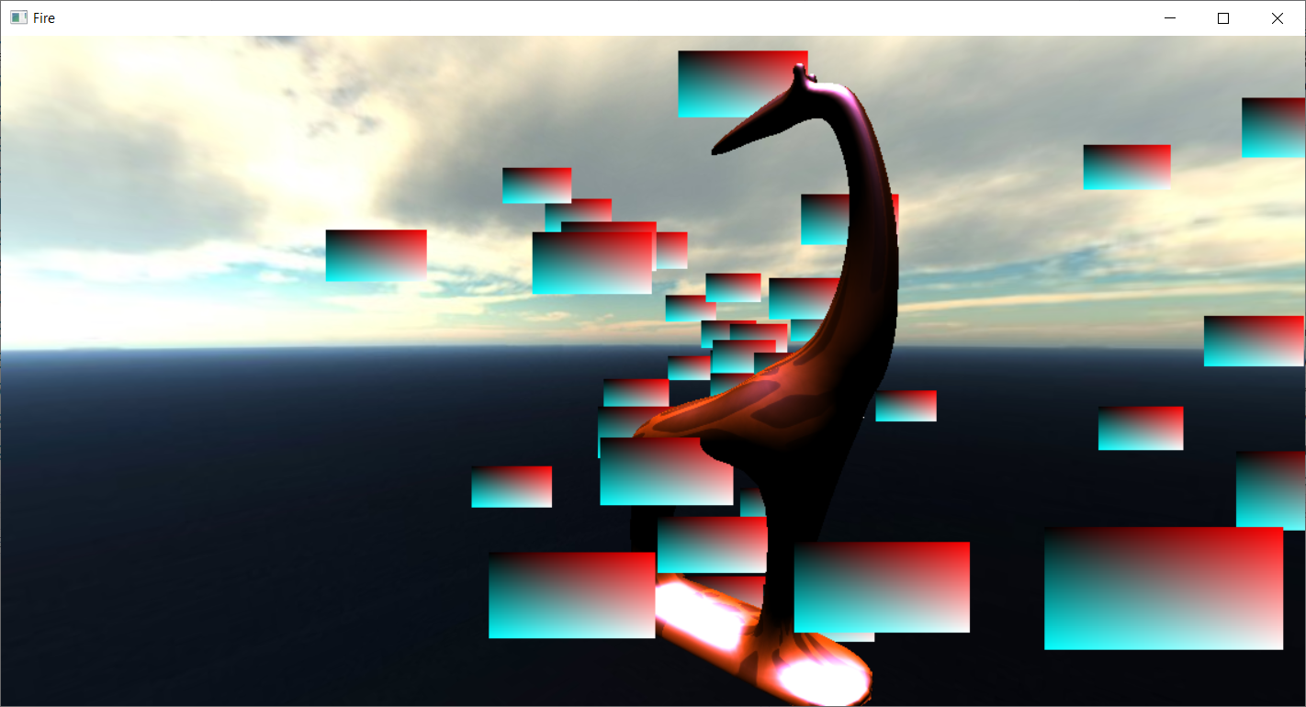
Eredmény

Slide 28
Particle.png
letöltés a Media folderbe
srvHeap mintájára particleSrvHeap
CreateResources-ben létrehozás
ReleaseResources-ben elengedés
UploadResources-ben materialba
SetSrvHeap
particleTex [particle.png]
LoadTexture2D
particleTex.CreateSRV

Slide 29
FirePS
a zsiráf színtextúrájának mintájára
Texture2D
SamlerState
Sample()

Slide 30
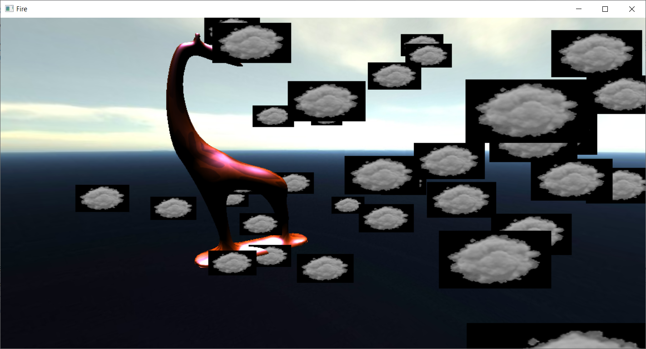
Eredmény: viewportarányú billboardok

Slide 31
main.cpp
// sorcsere
app->CreateResources();
app->CreateSwapChainResources();

Slide 32
ggl008App
void CreateSwapChainResources() override {
__super::CreateSwapChainResources();
camera->SetAspect(aspectRatio);
}

Slide 33
Állandó méretű plakátok
Update-ben
billboard méretet szorozzuk a kamera projekciós mátrixával

Slide 34
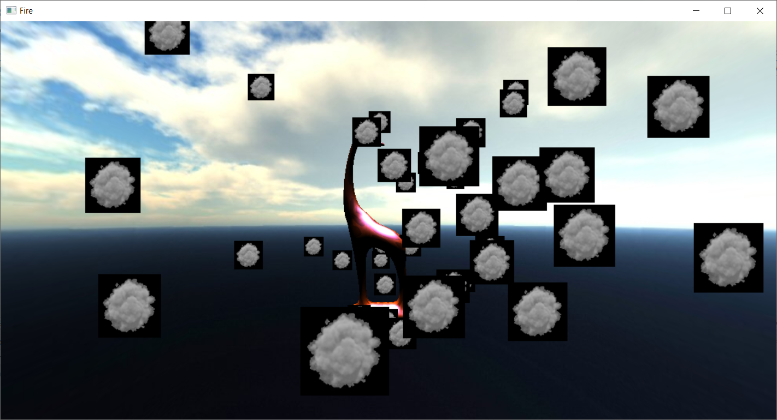
Eredmény

Slide 35
LoadAssets
D3D12_BLEND_DESC transparency;
transparency.AlphaToCoverageEnable = false;
transparency.IndependentBlendEnable = false;
transparency.RenderTarget[0].BlendEnable = true;
transparency.RenderTarget[0].BlendOp = D3D12_BLEND_OP_ADD;
transparency.RenderTarget[0].BlendOpAlpha = D3D12_BLEND_OP_ADD;
transparency.RenderTarget[0].LogicOpEnable = false;
transparency.RenderTarget[0].LogicOp = D3D12_LOGIC_OP_NOOP;
transparency.RenderTarget[0].DestBlend = D3D12_BLEND_INV_SRC_ALPHA;
transparency.RenderTarget[0].DestBlendAlpha = D3D12_BLEND_INV_SRC_ALPHA;
transparency.RenderTarget[0].SrcBlend = D3D12_BLEND_SRC_ALPHA;
transparency.RenderTarget[0].SrcBlendAlpha = D3D12_BLEND_SRC_ALPHA;
transparency.RenderTarget[0].RenderTargetWriteMask = 0xfu;
fireMaterial->SetBlendState(transparency);

Slide 36
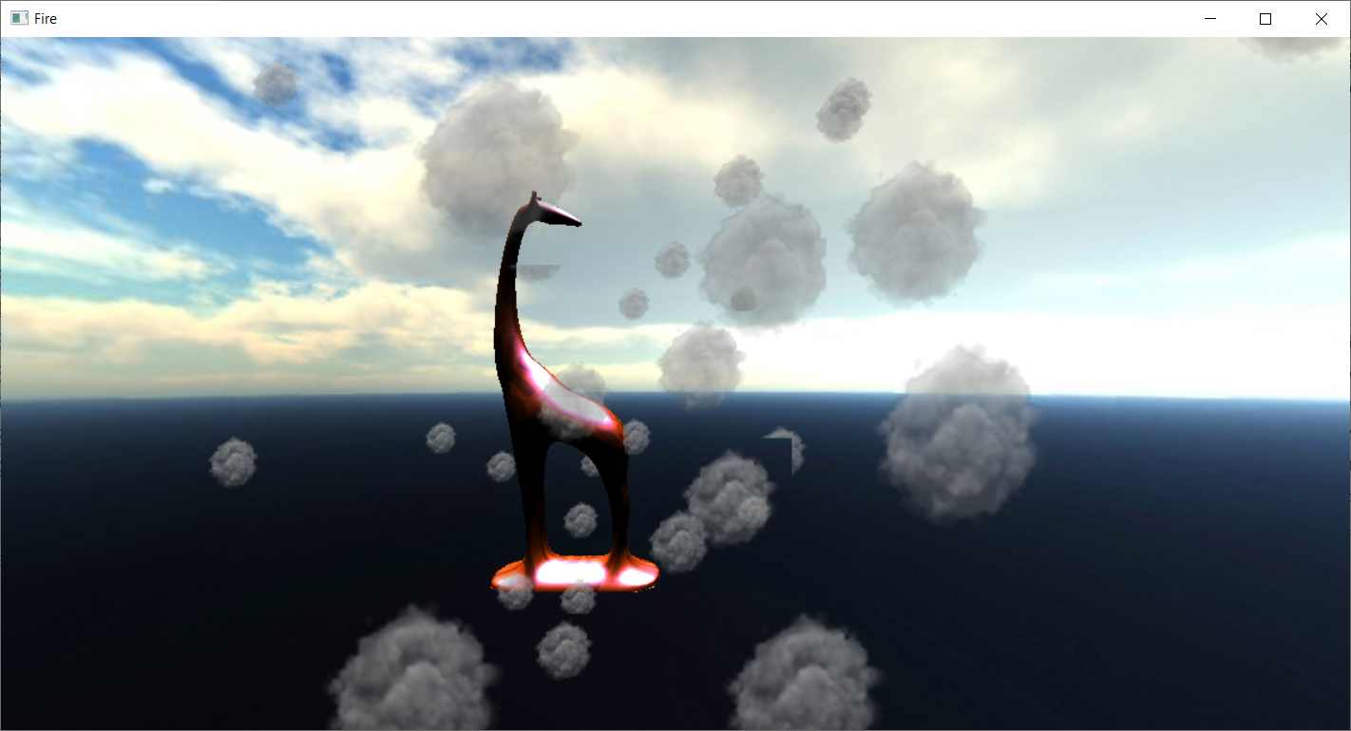
Átlászó plakátok???

Slide 37
LoadAssets
D3D12_DEPTH_STENCIL_DESC dd;
dd.DepthEnable = false;
dd.DepthFunc = D3D12_COMPARISON_FUNC_LESS;
dd.DepthWriteMask = D3D12_DEPTH_WRITE_MASK_ALL;
dd.StencilEnable = false;
fireMaterial->SetDepthStencilState(dd);

Slide 38
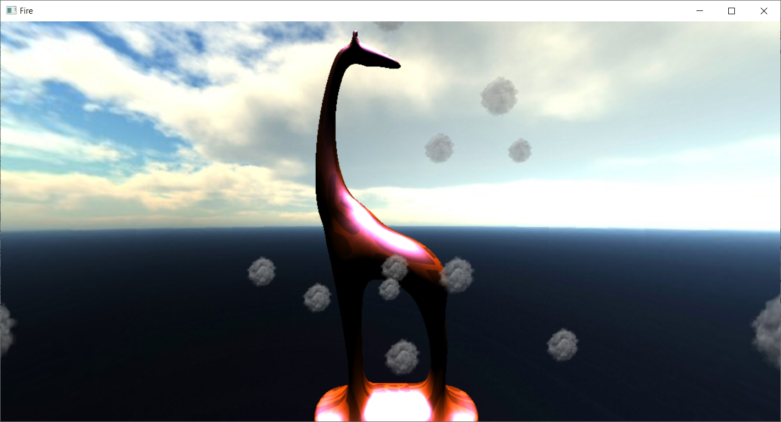
Mélységteszt nélkül

Slide 39
LoadAssets
D3D12_DEPTH_STENCIL_DESC dd;
dd.DepthEnable = true;
dd.DepthFunc = D3D12_COMPARISON_FUNC_LESS;
dd.DepthWriteMask = D3D12_DEPTH_WRITE_MASK_ZERO;
dd.StencilEnable = false;
fireMaterial->SetDepthStencilState(dd);

Slide 40
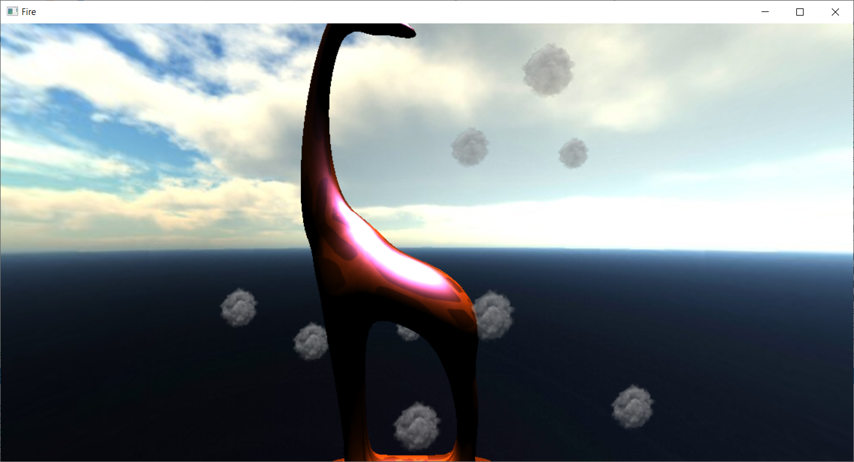
Mélységírás nélkül

Slide 41
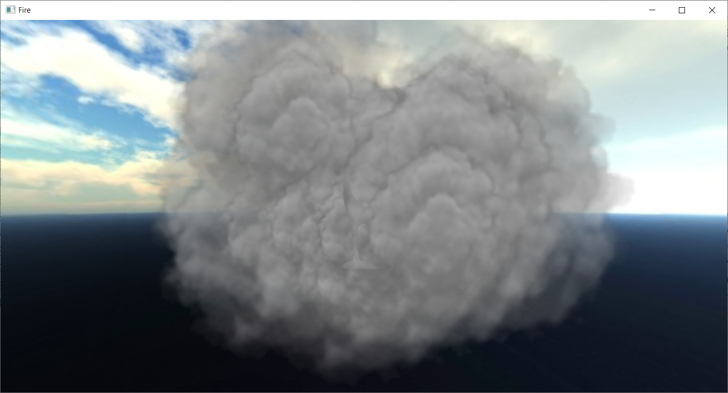
Nagyobb méret... hibás sorrend?

Slide 42
LoadAssets
transparency.RenderTarget[0].DestBlend = D3D12_BLEND_ONE;

Slide 43
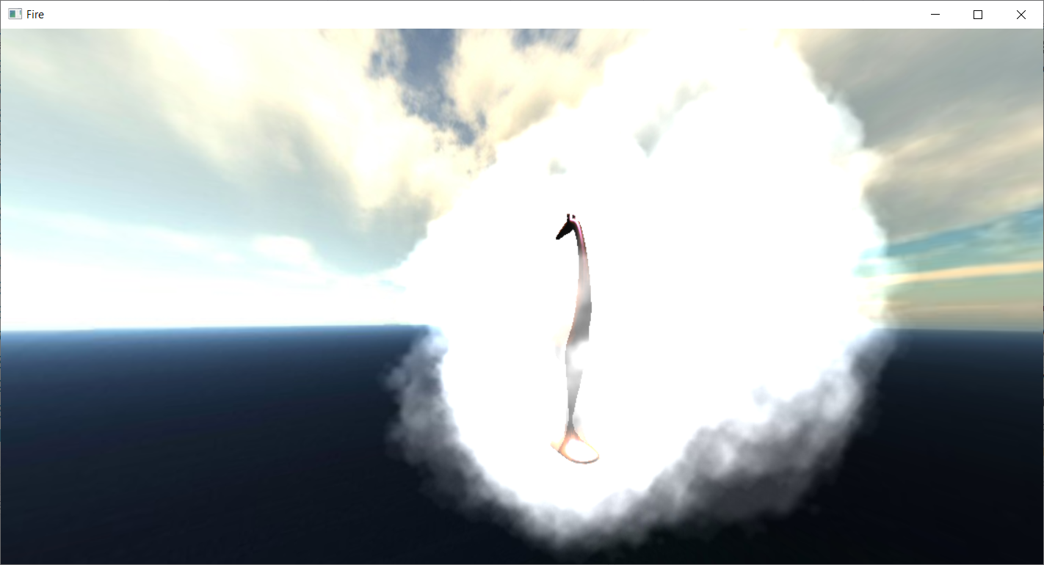
Additív

Slide 44
Színesebb FirePS
float4 color = particleTexture.Sample(sampl, input.tex.xy);
color.rgb = float3(color.a,
pow(color.a, 4),
pow(color.a, 10));
return color;

Slide 45
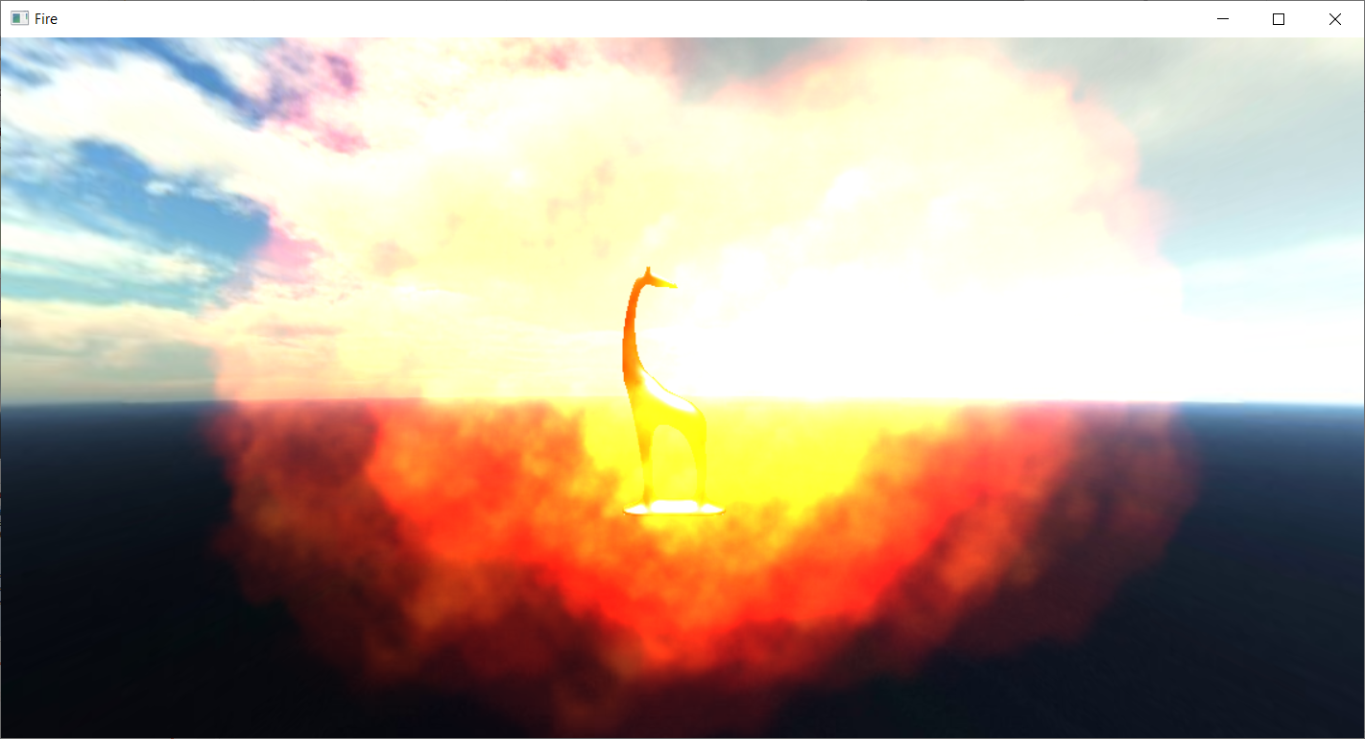
Eredmény

Slide 46
Particle
void move(float dt)
{
position +=velocity * dt;
age += dt;
if(age > lifespan)
reborn();
}

Slide 47
VertexStreamGeometry
void SetData(const void* data, unsigned int sizeInBytes) {
CD3DX12_RANGE readRange{ 0, 0 };
void* mappedPtr = nullptr;
DX_API("Failed to map vertex buffer (VertexStreamGeometry)")
vertexBuffer->Map(0, &readRange, &mappedPtr);
memcpy(mappedPtr, data, sizeInBytes);
vertexBuffer->Unmap(0, nullptr);
}

Slide 48
Update
for(int i = 0; i < particles.size(); i++)
particles.at(i).move(dt);
particlesGeometry->SetData(particles.data(), particles.size() * sizeof(particles[0]));

Slide 49
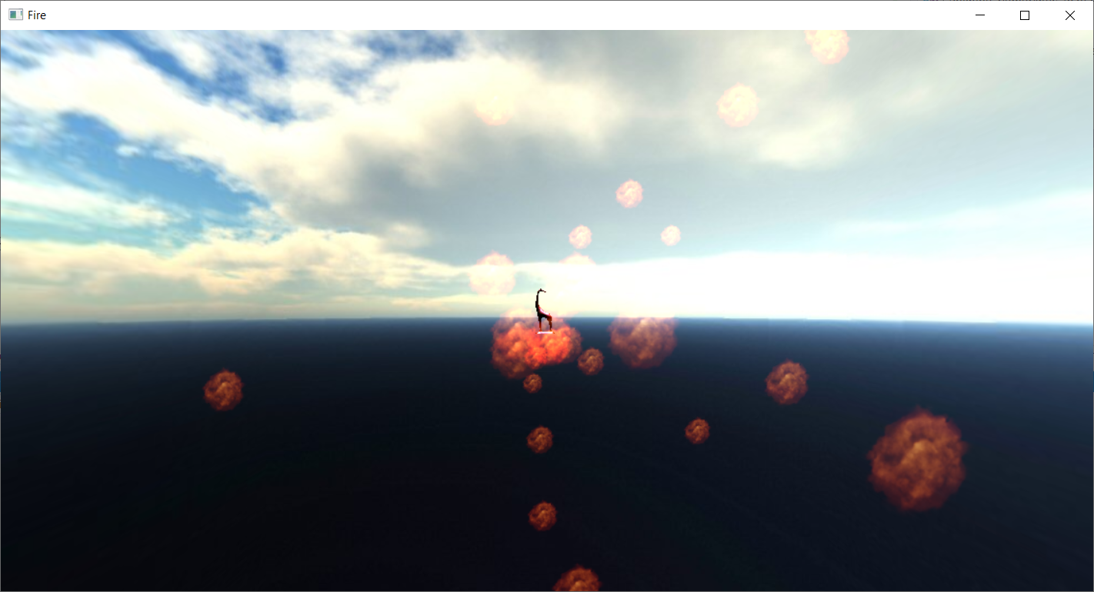
Mozgó részecskék, de hirtelen tűnnek el

Slide 50
Megoldás
Korfüggő méret, intenzitás és átlátszóság

Slide 51
BillboardGS
struct GSOutput
{
float4 pos : SV_Position;
float2 tex : TEXCOORD;
float opacity : OPACITY;
};
float s = input[0].age / input[0].lifespan;
...
output.opacity = 1 - abs(s*2-1);
// és mindenhol szorozzuk s-sel a szélességet és magasságot

Slide 52
FirePS
color.a *= input.opacity;

Slide 53
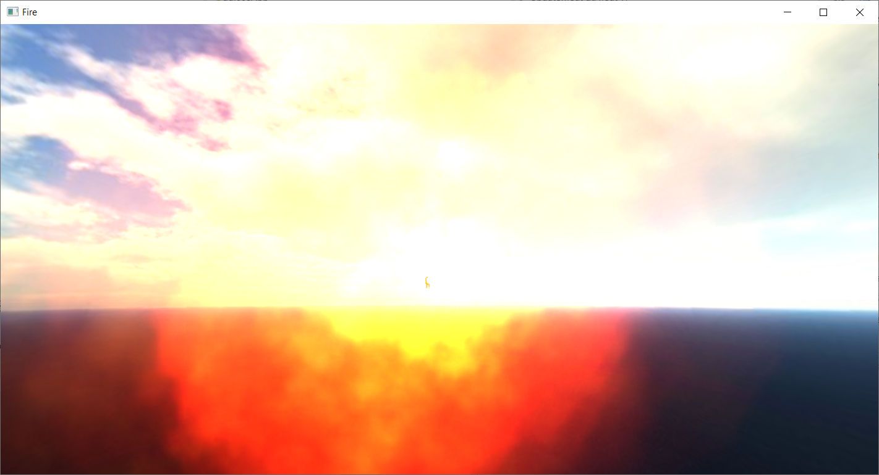
Simább tűz

Slide 54
Takarásos blending
transparency.RenderTarget[0].DestBlend = D3D12_BLEND_INV_SRC_ALPHA;

Slide 55
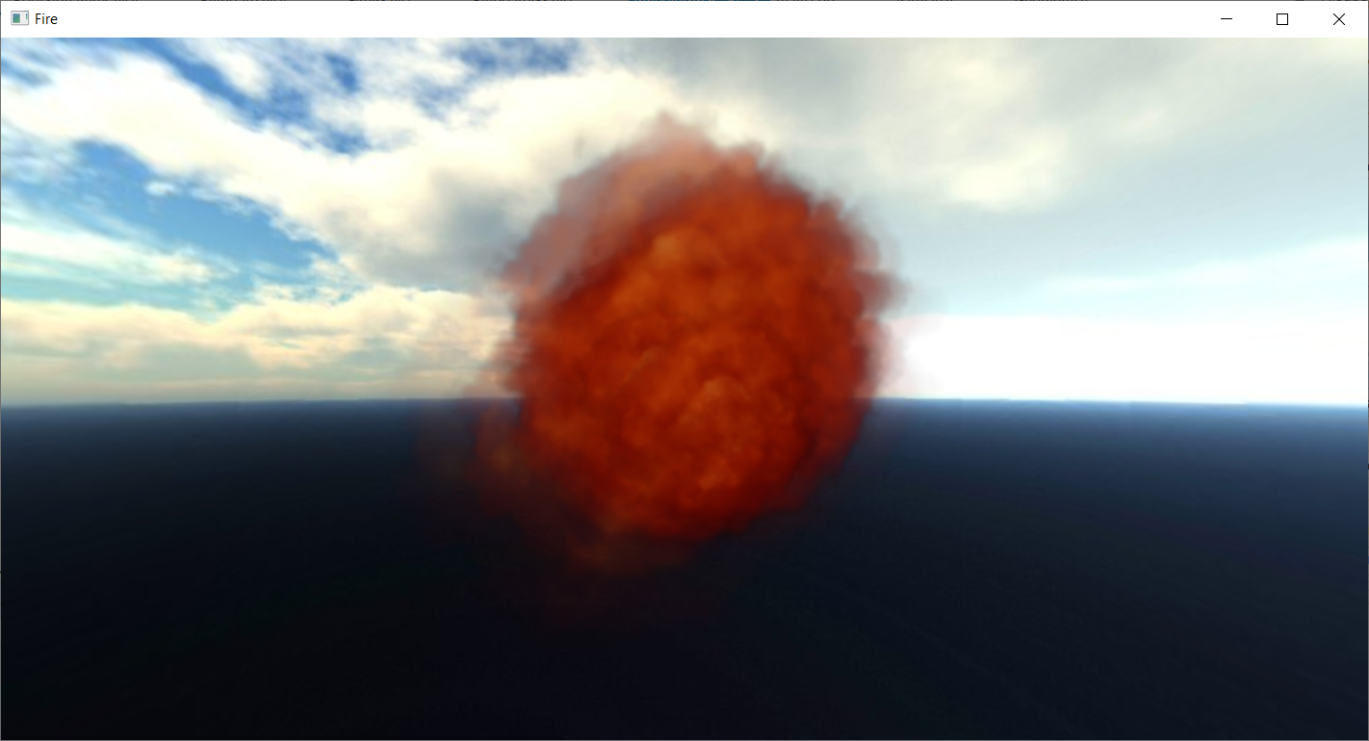
Hibás sorrendezés

Slide 56
Rendezés az Update-ban
#include <algorithm>
using namespace Egg::Math;
struct CameraDepthComparator {
Float3 ahead;
bool operator()(const Particle& a,
const Particle& b) {
return
a.position.Dot(ahead) >
b.position.Dot(ahead) + 0.01;
}
} comp = { camera->GetAhead() };
std::sort(particles.begin(), particles.end(), comp);

Slide 58
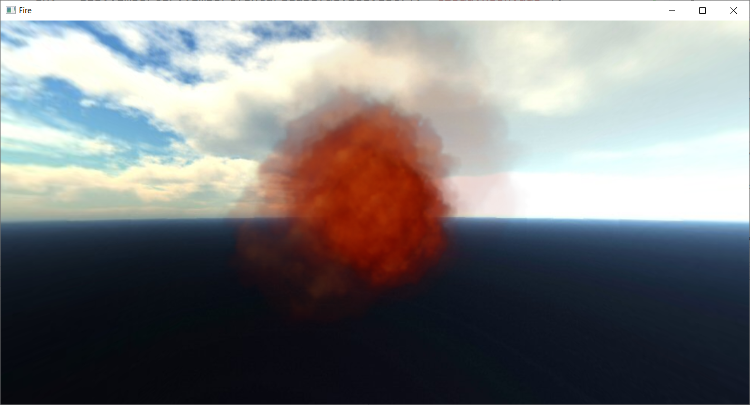
Jó, de van popping, amikor egymás elé kerülnek

Slide 59
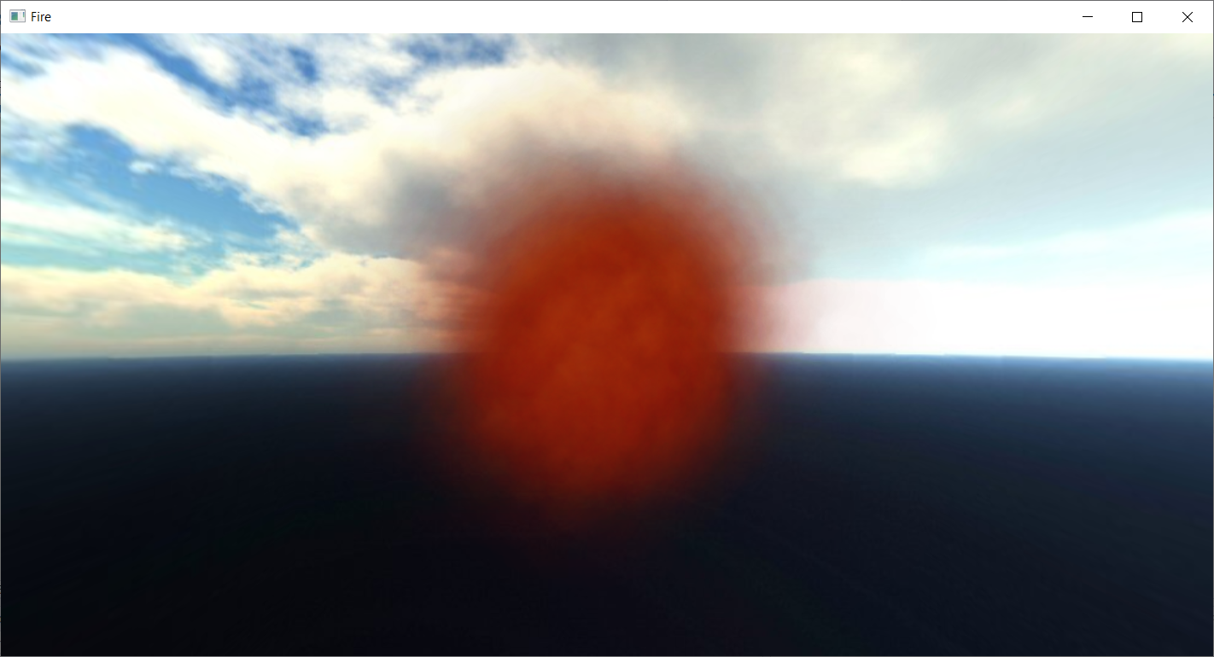
Több, átlátszóbb részecske

Slide 60
Szorgalmi/háziötletek
több (azonos ) példányban megjelenített részecskerendszer
egymás közötti takarások?
több különböző textúrájú részecskerendszer
egymás közötti takarások?
textúratömbben a lehetséges billboardtextúrák, összes billboard/rendszer rajzolása egyetlen menetben

